Slide 1




FH Ethiopia RFSA/PReSREVE Project ZiquaZIZ Project
GO & NGO forum
December 09, 2022
SEQOTA

Slide 2
Contents
Project Profile
Major Project activities accomplished
Budget Utilization
Lesson Learned
Major Challenges
Next Plan/Next Priories e Priorities

Slide 3
Project Profile
Project name: Poverty reduced sustainably in an environment of resilient and vibrant economy (PReSERVE) Project-Support PSNP V
Project Period: A five-year project: Oct 1st, 2022 – Sep,30th, 2026
Goal: is improving Food Security of vulnerable HHs in targeted PSNP communities and contributing to a sustained reduction in rural poverty.
RFSA/PReSERVE Project implemented in 11 Woredas of Amhara Region. Wag Himra Zone (Ziquala, Abergele and Sahila).
It targets to reach 271,231 BNFs residing in 179 kebeles in the 9 target woredas in Amhara Region, Ethiopia. Wag=175,707 PSNP+Non-PSNP)
3

Slide 4
Con'd….
FH is PReSERVE project consortium lead and implementer Partners (RTI, IDE, Dimagi, BDU, PADet, ADA and SMTN)
Major Counterpart Organizations: Regional, Zonal and Woreda level gov’t line offices, PSNP partners
Budget allocated = $ 15,404,390.05 (AB), $ 14,817,670.93 (ZIQ) = 1,57 Billion ETB
Targeted intervention kebeles: 32 Kebeles (17 AB & 15 ZIQ)
PReSERVE is a multi-sectoral activity including: Food transfers, Community asset building, Agri & Livelihood, VCs and market dev’t, Youth & Gender empowerment, WASH, H&N, LSCB, DRR as key sectors.
SBC, SA and Env’t as main crosscutting themes.

Slide 5


Project Design
Goal: Improved Food Security of Vulnerable households in Targeted Productive Safety Net Program (PSNP) Communities Contributing to a Sustained Reduction in Rural Poverty
Purpose 1: Vulnerable Households and Individuals have Sufficient Quantity, Quality, and Diverse Foods are Available and Accessible at All Times,
Purpose 2: Vulnerable Community Members’ Livelihoods Transformed Production
Purpose 3: PSNP Systems Deliver Accountable, Effective, and Shock-Responsive Service. Moreover,
#3
#10
3 Sub-Purposes
3 Sub-Purposes
4 Sub-Purposes
4 Intermediate Outcomes
6 Intermediate Outcomes
7. Intermediate Outcomes
#17
>#280
>280 Planned Activities for each FY - Under 8 Components

Slide 6
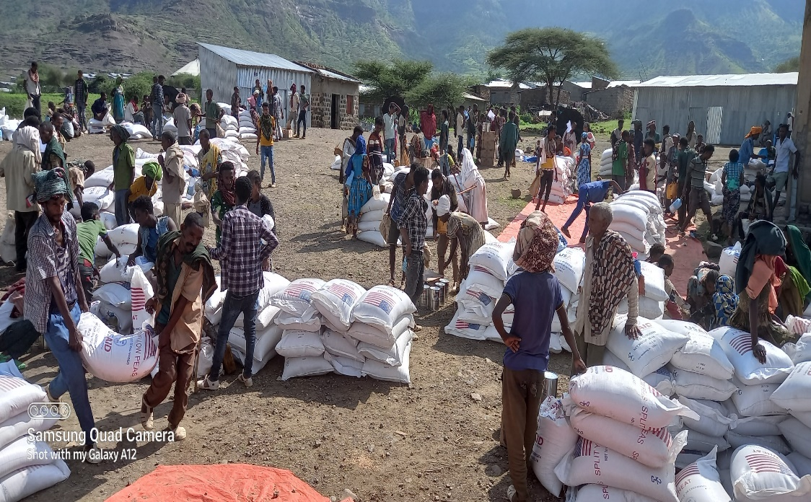
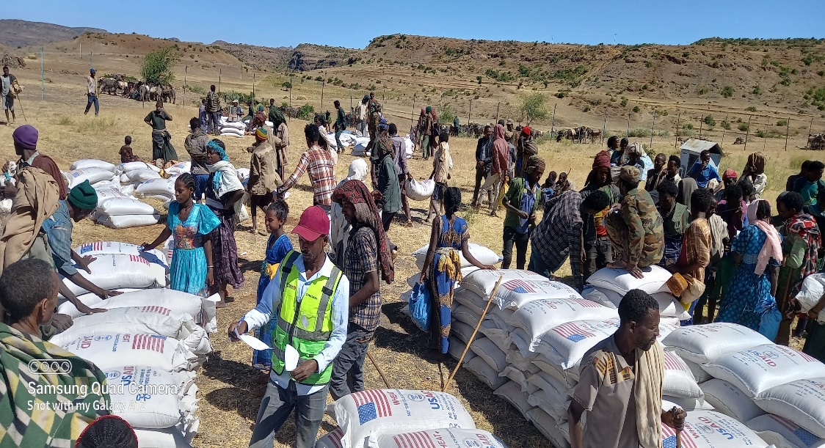
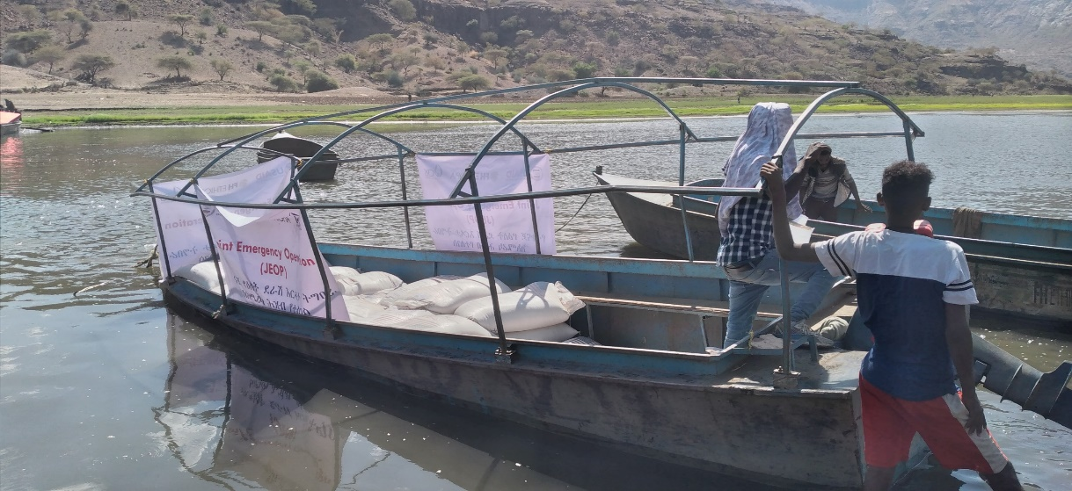
Major Project Activities Accomplished
Food Transfers (80% the Resources)
FH is provided food transfers to the PSNP clients for 9 month (Provide additional rounds of food transfers to the PW-PSNP clients for 3 month),
45,187 PDS/PW clients in (AB & ZIQ)
A total of 4,353.98 MT distributed for targeted PDS/PW HHs.
FH also continue to ensure the integration of the JEOP and the PReSERVE/RFSA resources to address the needs of all conflict-affected communities. the JEOP round 5 support = 99,845 People

Slide 7
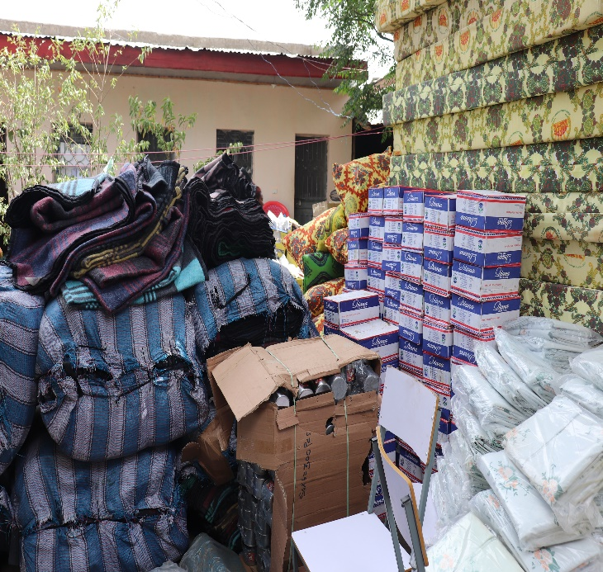
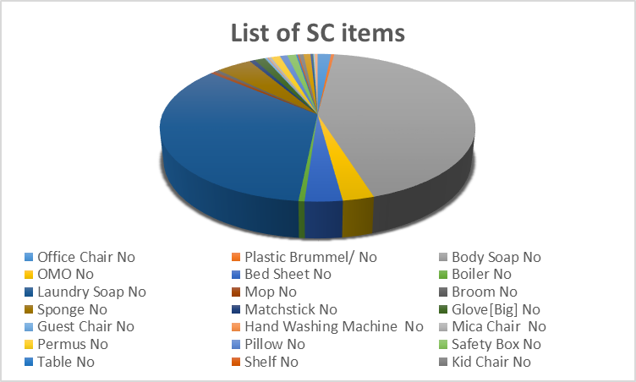
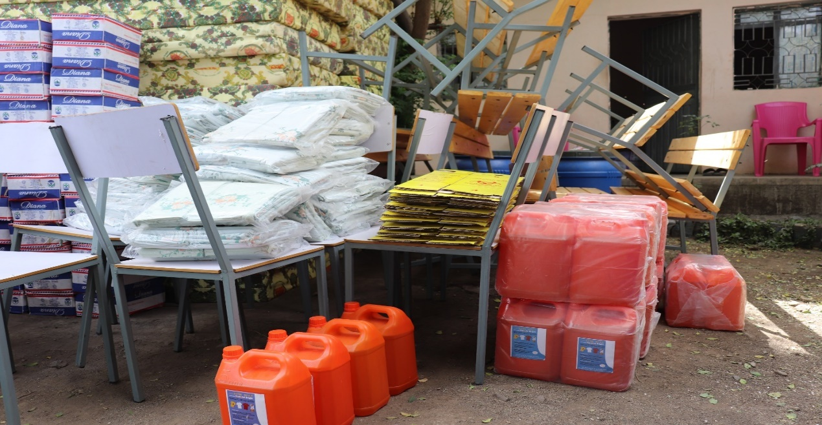
Con’d
Health and Nutrition
Support to SC
FH was delivered SCs materials such as (8 bed, 80 bed sheet, 16 guest chair, 56 mattress pillow, 8 office table) for 8 SCs (4 ZIQ/4 AB)…1,248,000 ETB

Slide 8
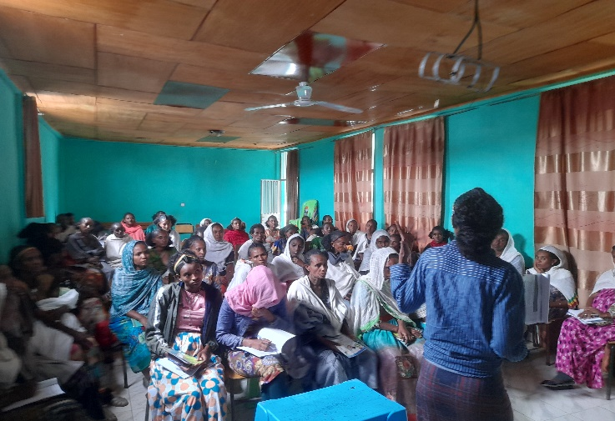
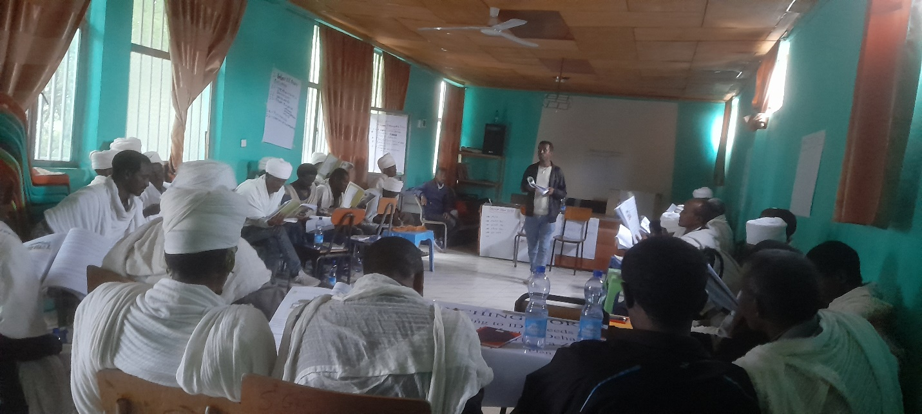
Con’d…
Health and Nutrition
Training
ToT training for 4 woreda HC >5 focal person officers on CMAM for 7 days at Bahirdar to support Children SAM cases.
Train 330 (AB:123/ZIQ:207) Women Health Development Armies (WHDAs) on CMAM training for 3 days at Sekota.
ToT training for 54 HEWs and FH Promoters on Mental Health and Psycho Social Support [MHPSS]
Conducted training for 64 Religious and community leaders on Psychological First Aid (PFA)
202 group discussions session were organized among 2331 (1880f) selected community members on PM+.

Slide 9
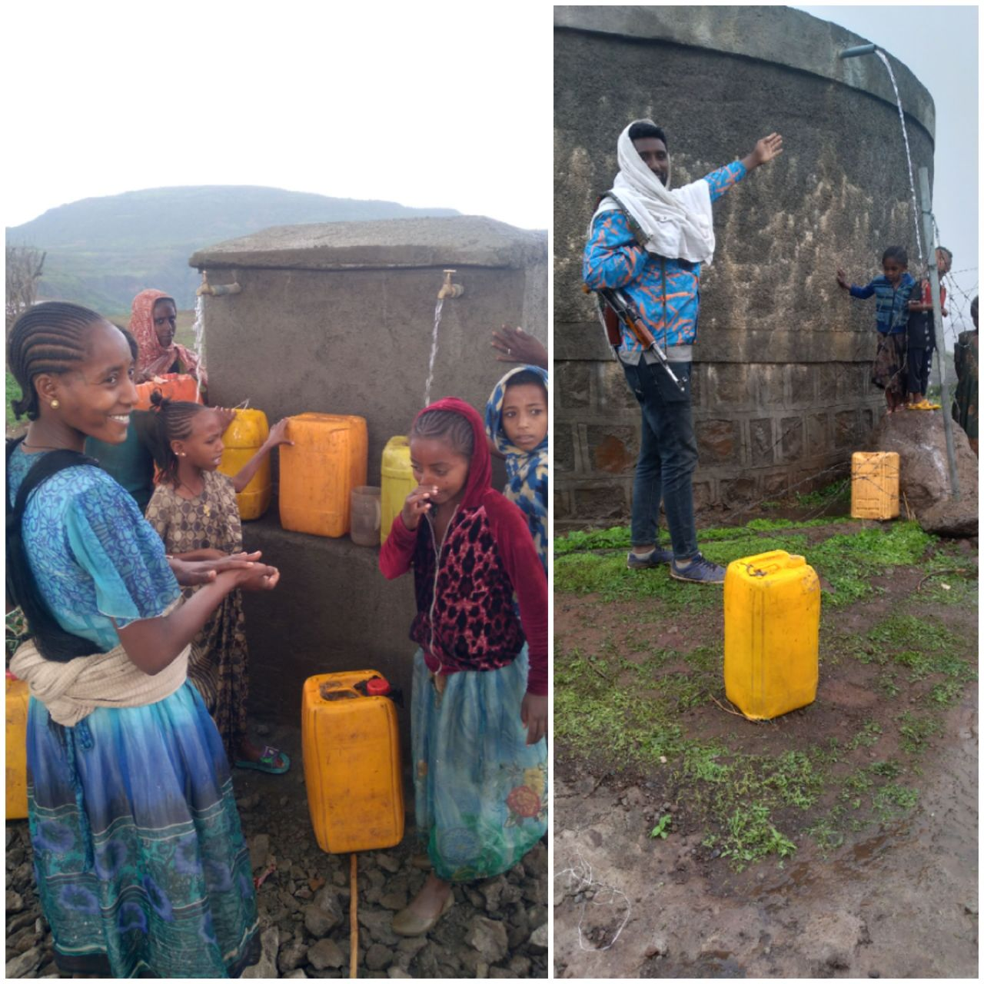
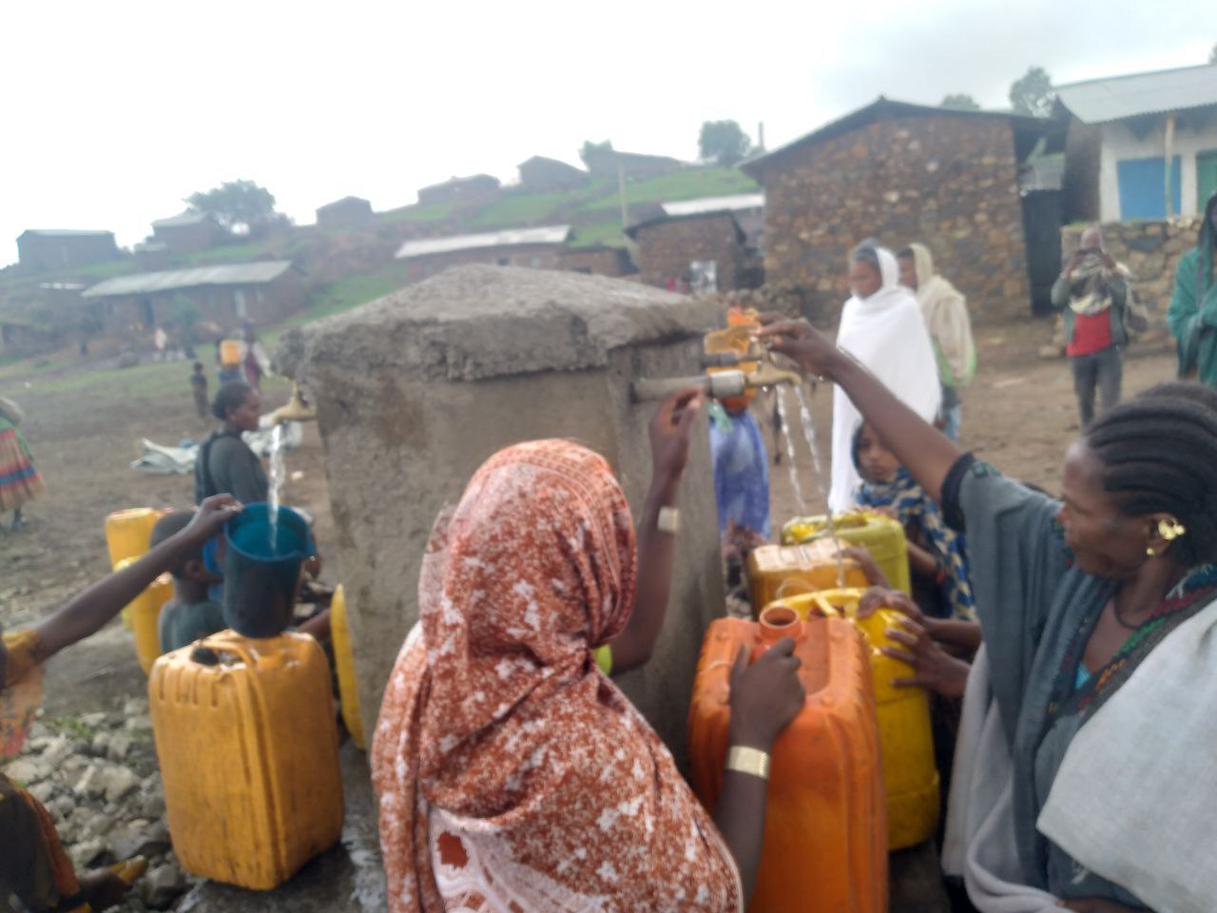
Con’d
WASH: Social Infrastructure
Rural piping system (RPS) for human consumption
One (1) RPS Rehabilitation constructed in Addisalem (012) Kebele, 14 (7F) WASH committee was trained and providing service for 5,860 (2512 female) 750,000 ETH

Slide 10
Con’d….
Water Supply and Sanitation
FH jointly with the Woreda Water Offices in Ziquala facilitated the repair and replacement of seven (7) broken water points….. 624,000 ETH
FH procured the tools and supplies required for the maintenance and repairs and contract local skilled workers, with the water user committees, conduct activities under the supervision of FH and government engineers…….. 36,000 ETH

Slide 11
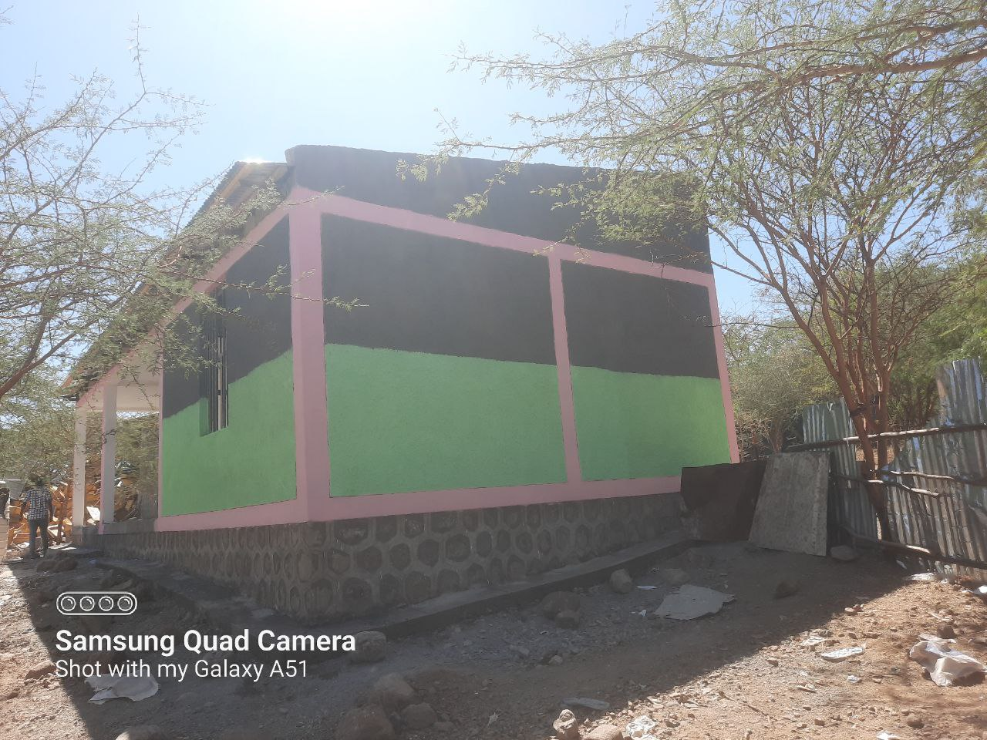
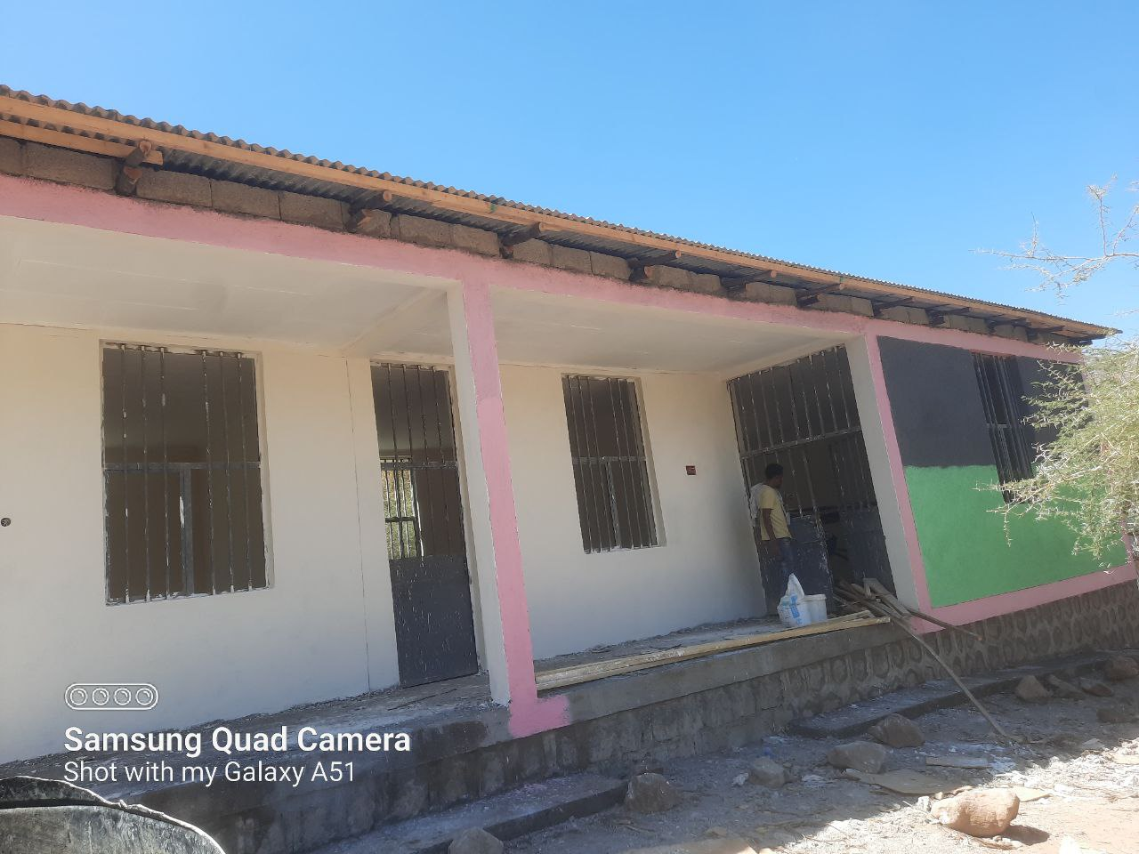
Con’d……
Vet Post construction
Vet post was constructed in Tsitsiqa (01) Kebele, Ziquala woreda and currently the handover to woreda will be completed,
The VIP latrine was constructed is the Vet post building compound
The project expected to serve a total of 1390 (655 F) farmers will be benefited. 2.3 million ETH

Slide 12
Con’d…..
Government Capacity Building
The government offices in the two woredas (Abrgelle and Ziquala) directly affected by the conflict have also experienced looting of office materials and supplies
Office Supplies and Materials: FH has procure and support 12 desktop computers, 6 laptop computers, 5 printers and 5 photocopy machines for Ziquala and Abergele woredas. ……..2,630,956 ETH
Office Furniture Maintenance and Procurement: FH has supported the maintenance of office furniture like (16 Shelf, 16 table, 16 chair)- 8 for each woreda…….1.2 million ETH

Slide 13
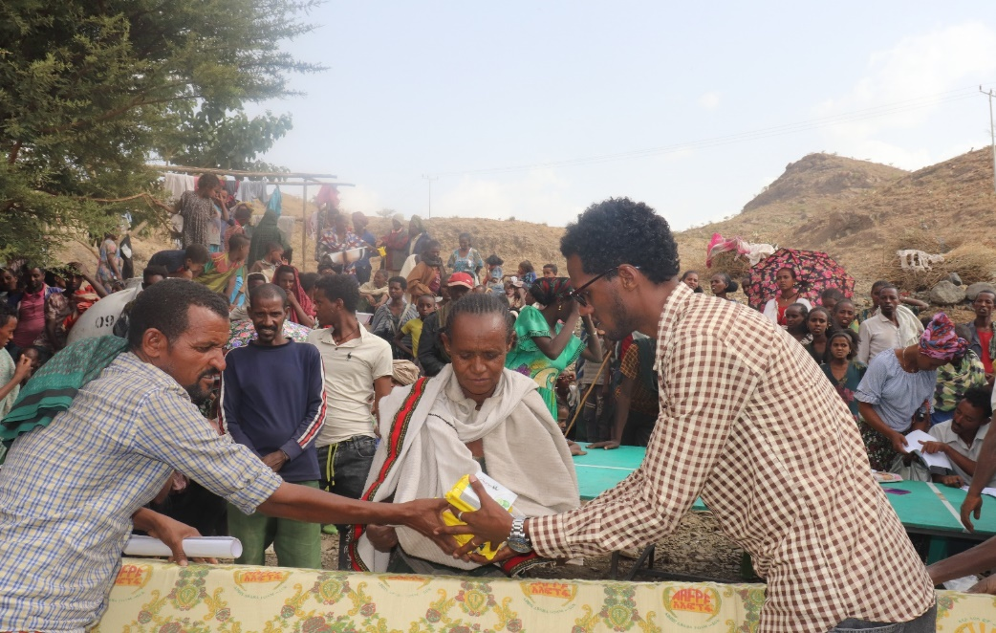
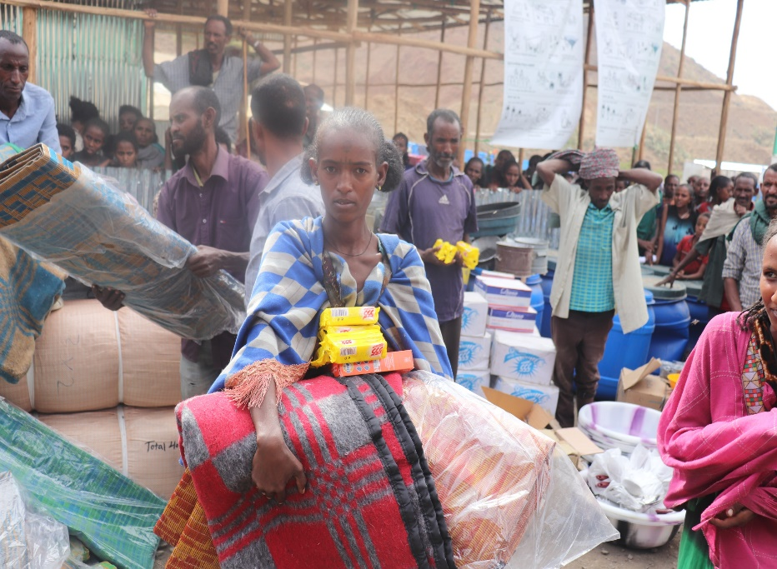
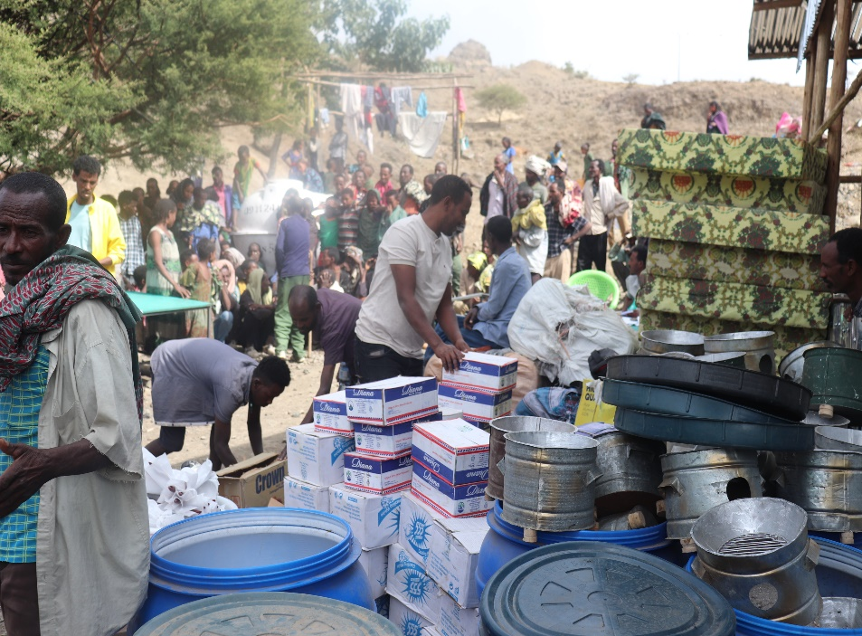
Con’d….
IDP Support
FH has allocated: 2.2 million ETH for ZIQ & AB IDPs as a result of the conflict situation occurred on the northern part of Ethiopia. + 2.95 million ETH (Cap & Adim-Abergele)
Provided NFI (32 type) for 4,139 IDPs HHs living in camps and host communities in AB & ZIQ

Slide 14
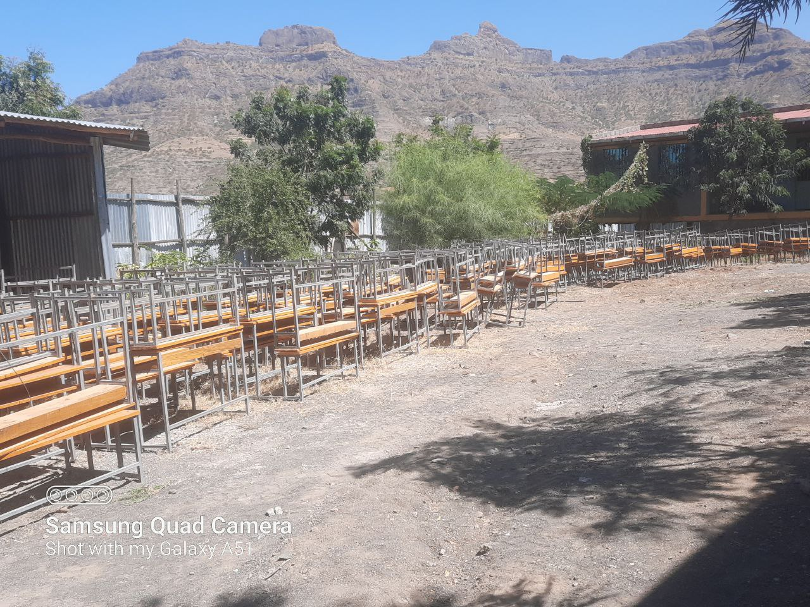
Con’d…..
School Support
FH has purchased to provide 4,971 books for each schools in ZIQ and AB, 358 combined desks & 158 blackboards in the ZIQ & 144 combined desks & 158 blackboards - AB. 3,830,880 ETB
It improve the learning environment & create access to education for 2,500 students… Maintenance of damaged social infrastructure
1 FTC, 2 FTC fence, 1 HP, 1 HC and 2 schools have been maintained….. 1.200,000 ETB

Slide 15
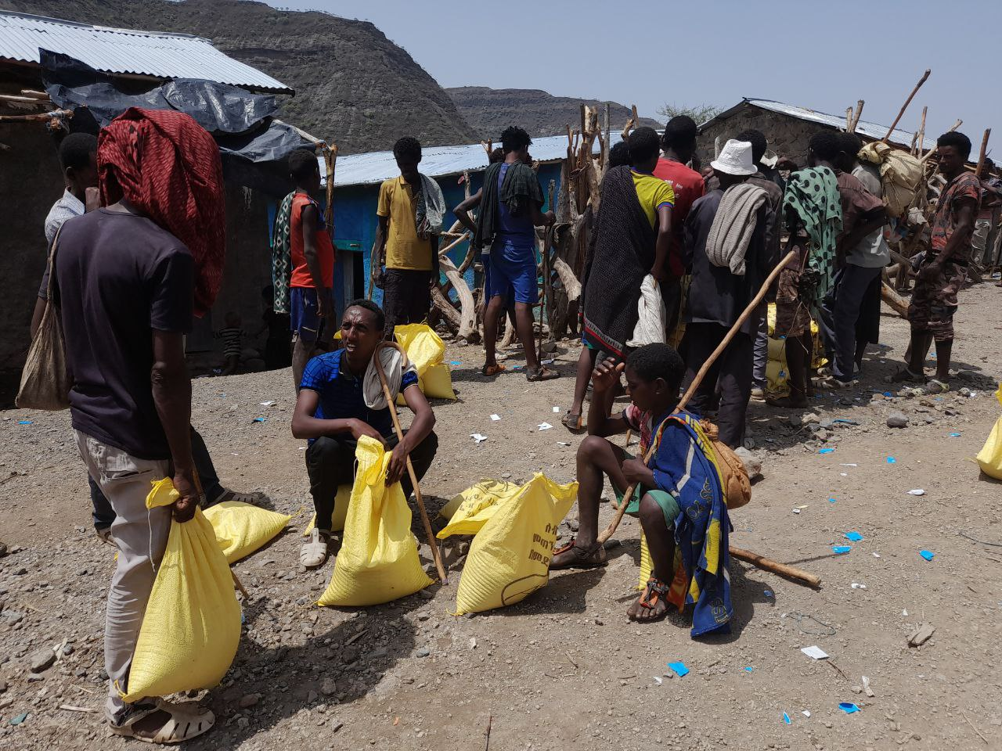
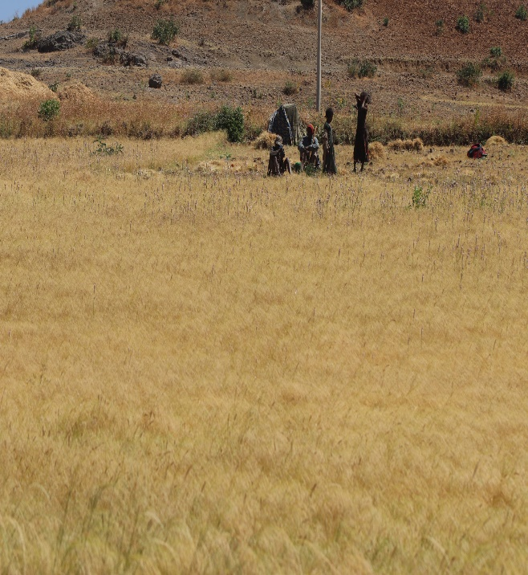
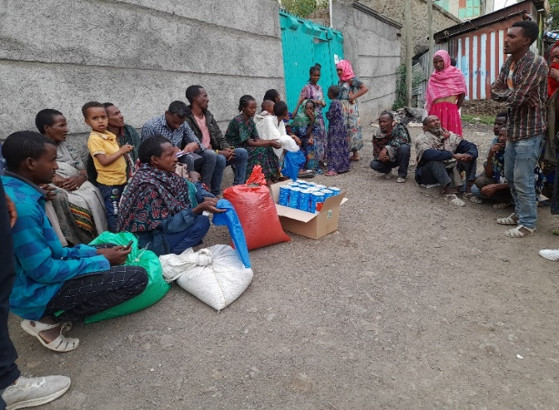
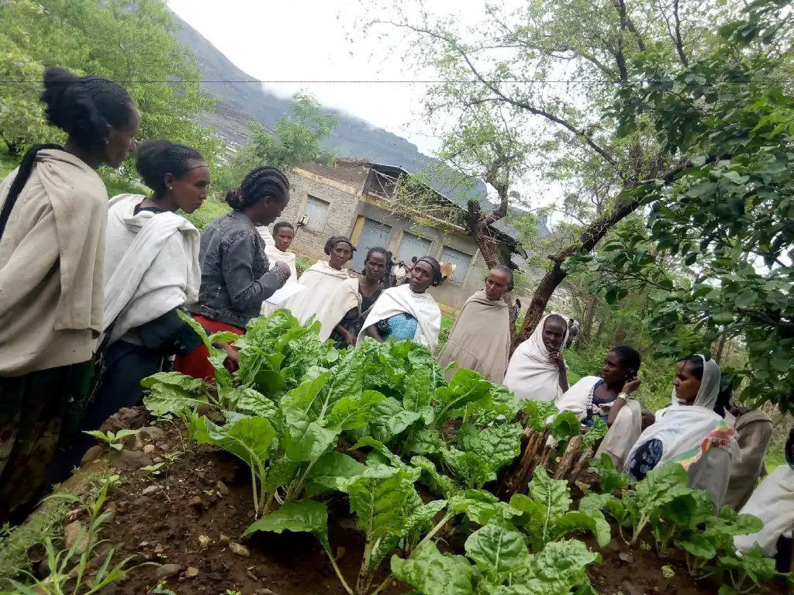
Con’d….
Livelihoods and Agriculture
Provision of Improved seed for farmers
FHE was purchased and distributed 186 qtal of improved teff and 26 qtal of wheat and as a result 2,182 (1206/F) targeted HHs benefited . 1,349,290 ETB
Provision of Improved Vegetable
The project was distributed 140 kgs of nutrient-rich vegetable seeds such as tomato, carrot, Swiss chard, lettuce, and onion, green pepper to support 822 (340F) HHs…551,340 ETB

Slide 16
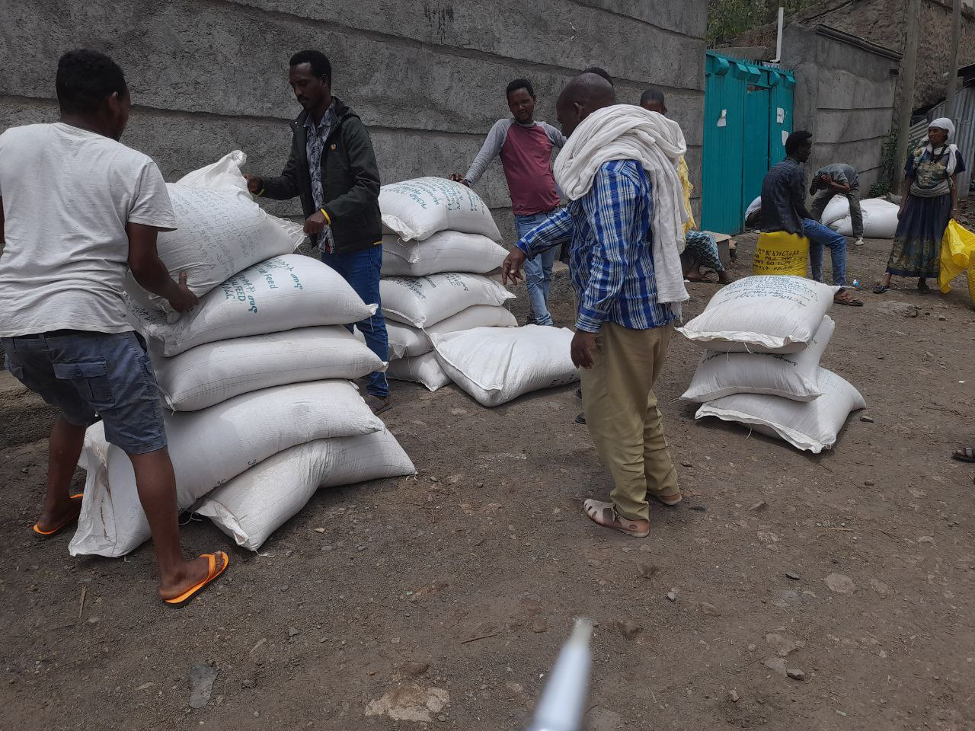
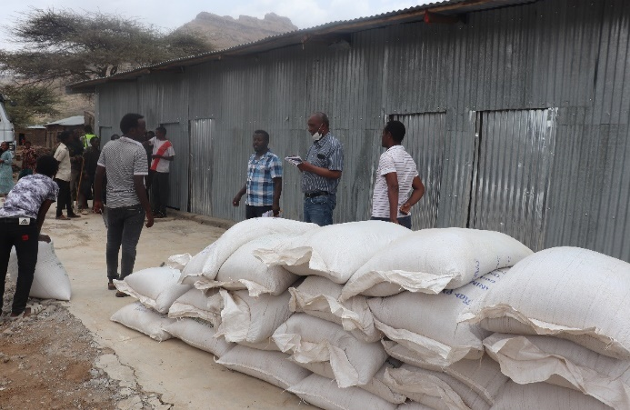
Con’d
Concentrated animal feed:
397 (ZIQ) & 84 (AB) = 481 Qtl concentrated feed purchased and distributed for 917 HHs, ZIQ- 274 HHs ( (102F) & 123 (83F) targeted BNF’s, ..1,160,960 ETB
Fodder Seed Provision:
50 kg pagan pea and 50kg cow pea purchased and distributed for 50 BNF to support livestock forage/fodder production using both irrigation and natural rainfall to increase the availability of fodder. ..25,000 ETB

Slide 17
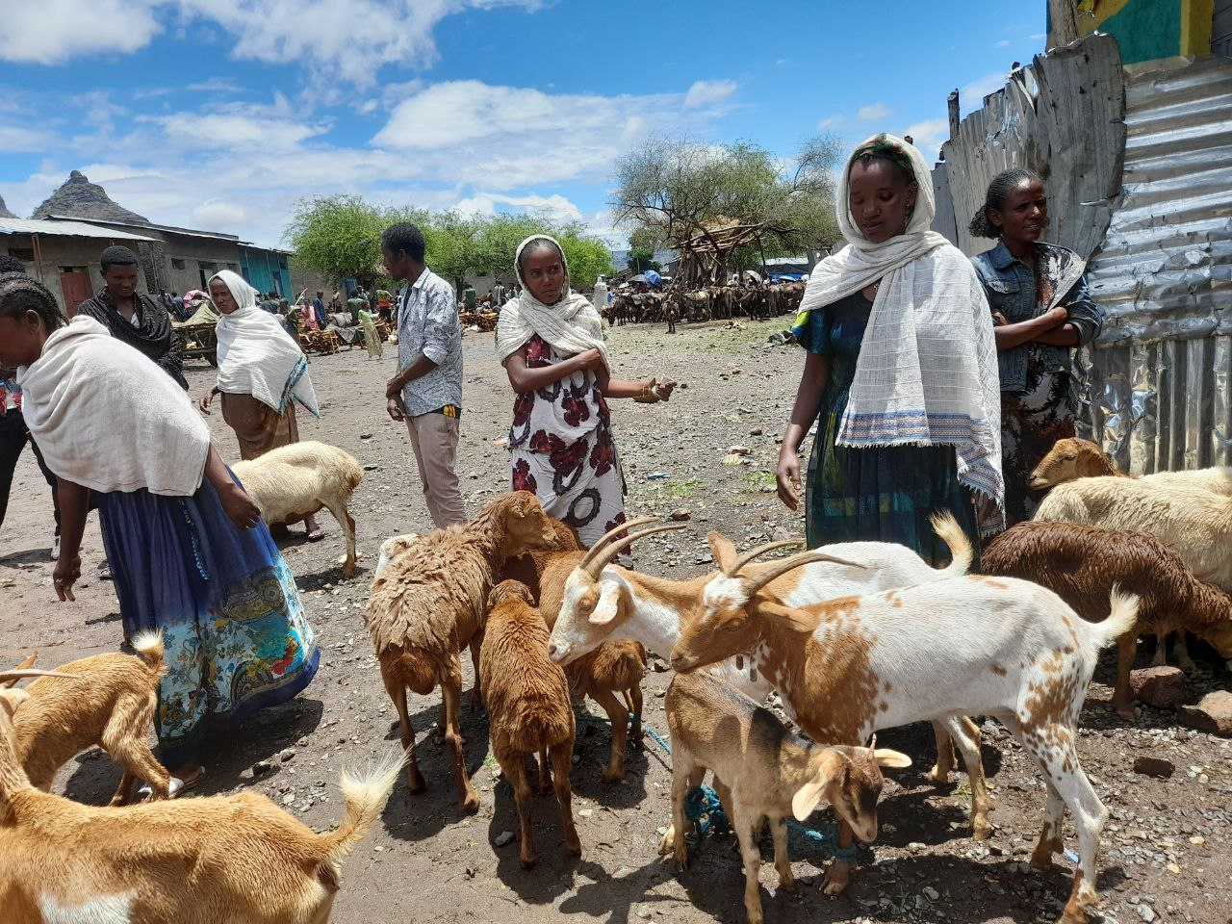
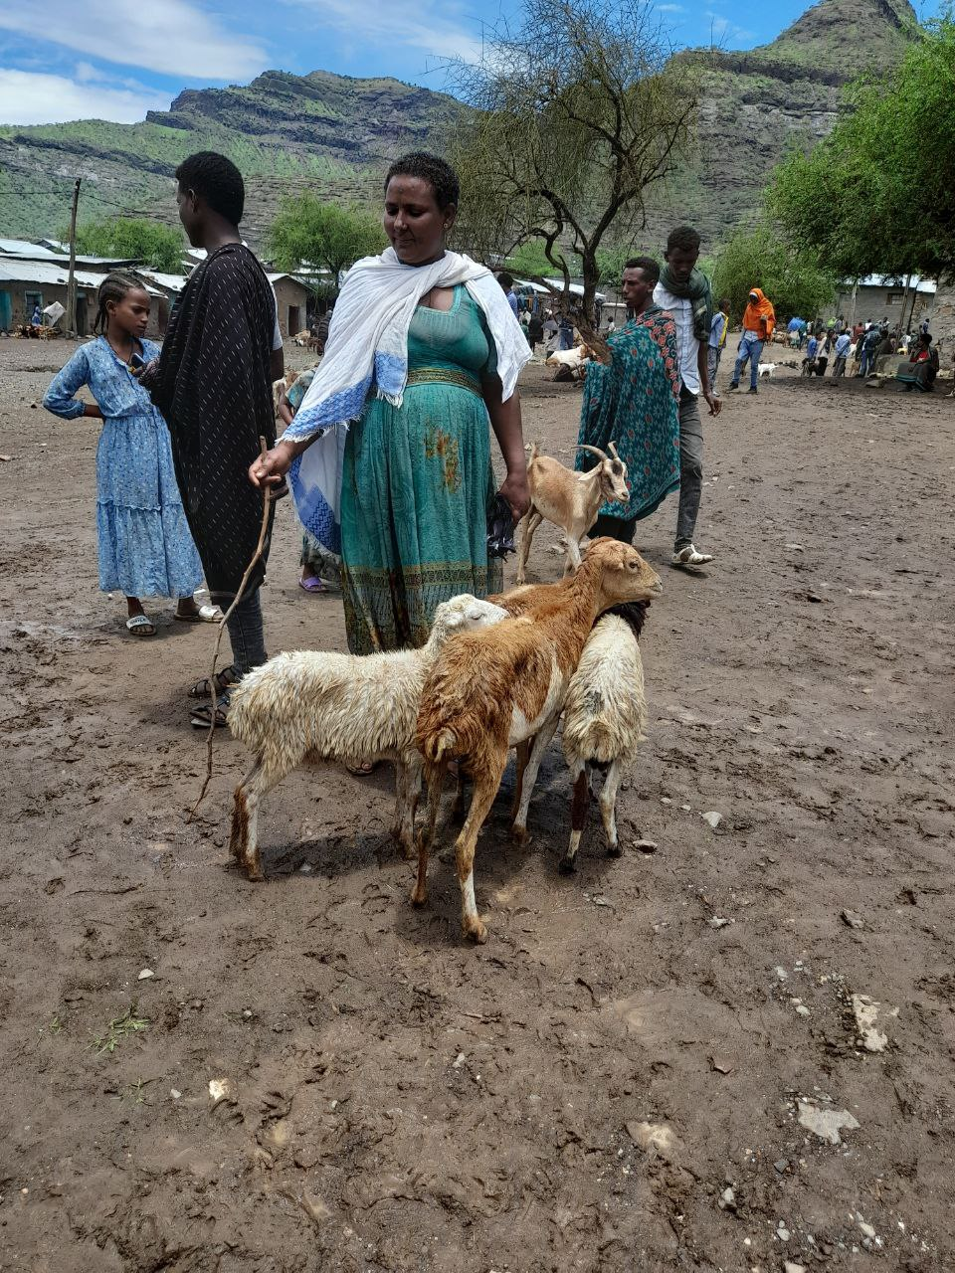
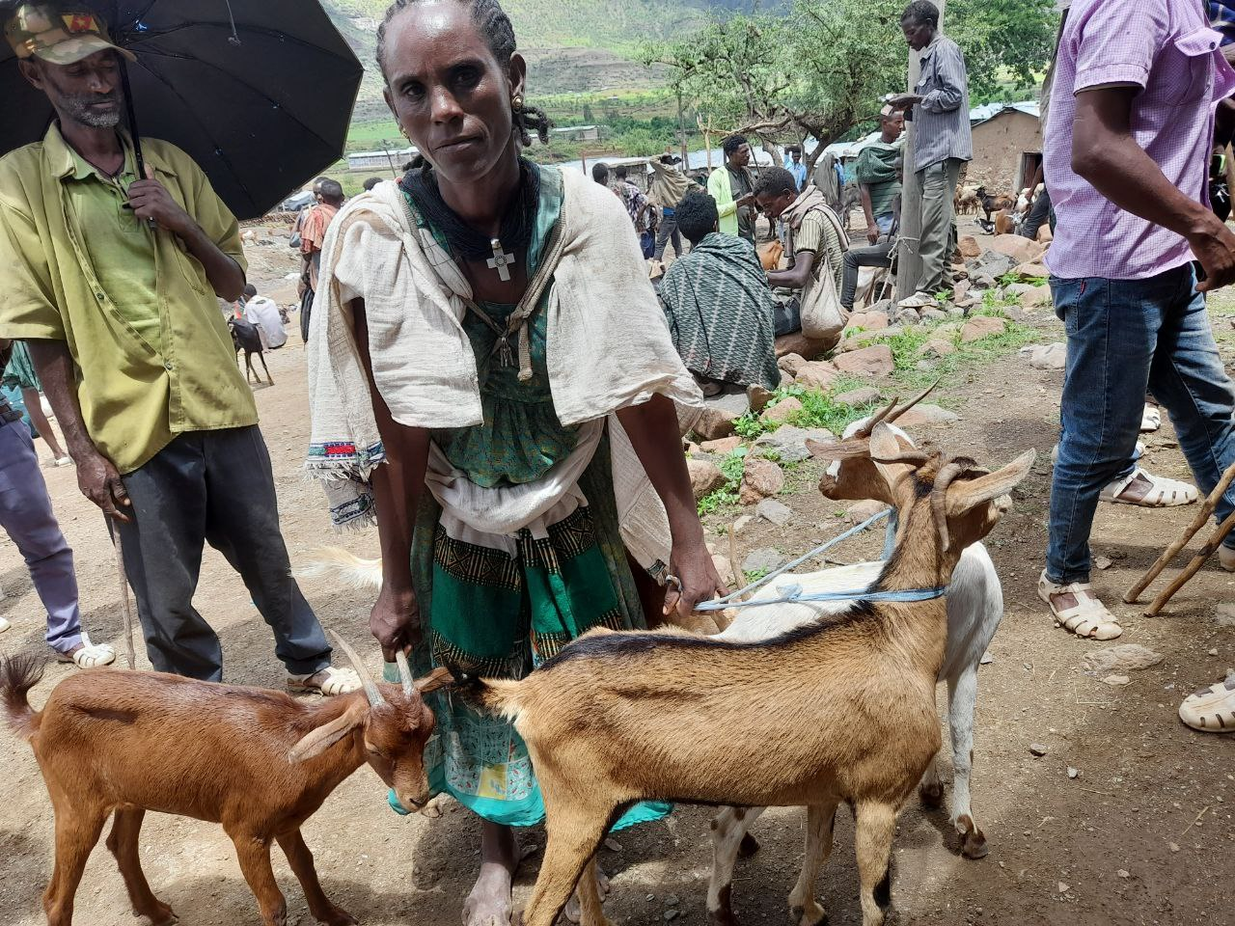
Con’d…...
Restocking: FH with the local government identified the target HHs and allocated 1.092,000 ETH and to purchase 410 small ruminants (goats and sheep) to 82 (all female PLW) conflict-affected HHs.

Slide 18
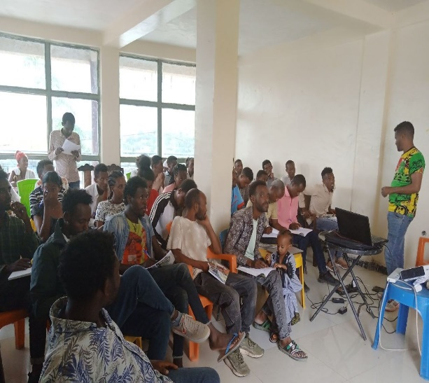
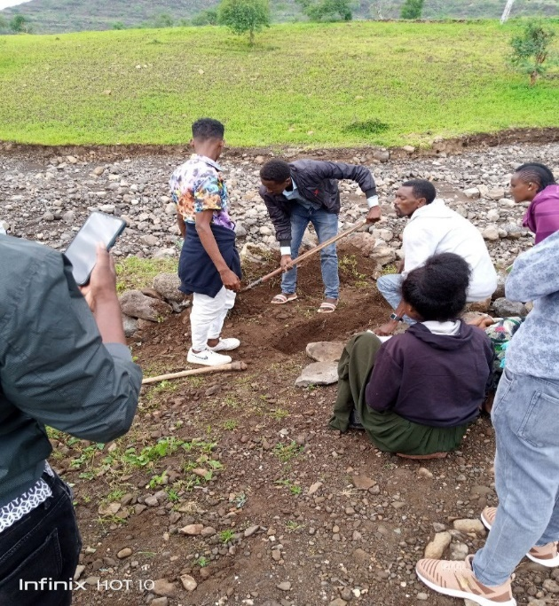
Con’d….
NRME Activities: Trainings
65 (16 f) DAs and site foremen/women trained on participatory watershed planning, utilization & SWC techniques.
Coordination meetings organized at kebele and Woreda level, 17 (male) woreda sector heads and team leaders
Organized Woreda level workshop for 31 woreda experts, sector leads and Kebele administrators on integration of mass mobilization and PWs.
Train 57 (10) community WS, FH and government staff on environmental and social management framework (ESMF)
Trained 12 youth (3F) on private nursery management.

Slide 19
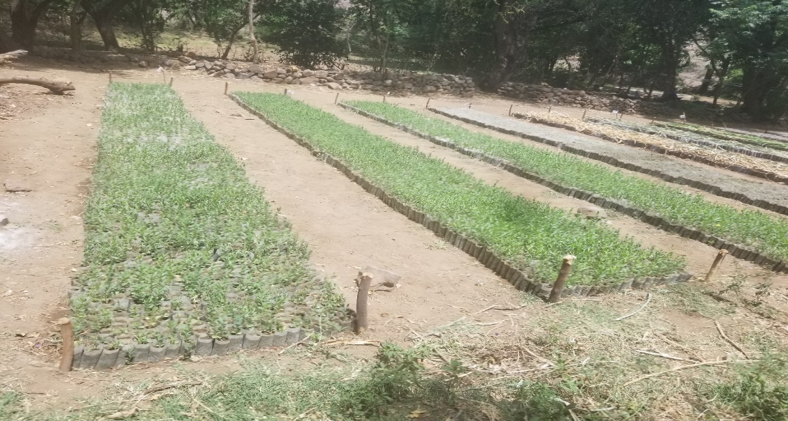
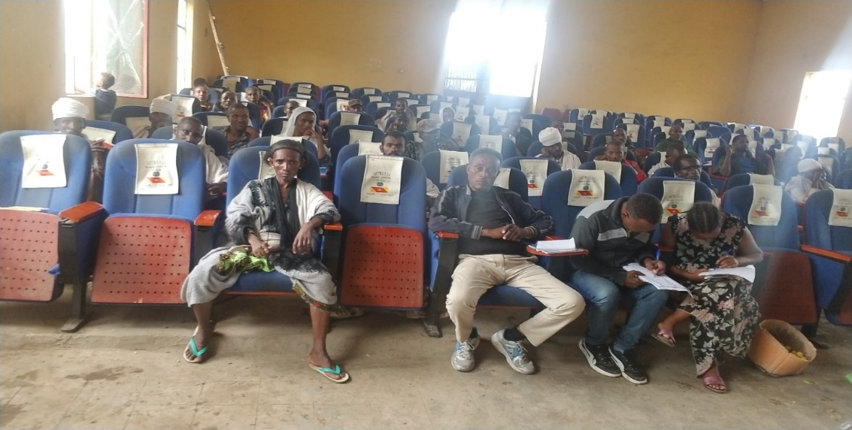
Con’d….
4 woreda center nursery sites are fully supported by FHE (material support and daily labour payment)
DRR activities
Trained 17 (5) woreda staff on EW data collection
Trained 55 (18f) DRR committee on information exchange & timely response

Slide 20
Budget Utilization
Woreda | Budget type | Plan ($) | Actual ($) | %
Ziquala | Regula Budget | 1,102,713.90 | 1,161,330.42 | 105%
 | PIVOT Budget | 1,102,713.90 | 1,161,330.42 | 105%
 | Total | 2,205,427.8 | 2,322,660.84
Woreda | Budget type | Plan ($) | Actual ($) | %
Abregele | Regula Budget | 1,136,058.72 | 740,721.48 | 65%
 | PIVOT Budget | 462,305.96 | 113,381.26 | 25%
 | Total | 1,598,364.68 | 854,102.74

Slide 21
Lesson Learned
Active participation of Gov’t & partners in project:- ensure the project to be sustainable, create sense of ownership etc…
Making strong follow up and Monitoring on each activities, it enables to implement quality works.
Integrating gender in project activities has increased women engagement in project intervention
Conducting regular review meetings minimizes the gap and challenges, tendency to use the program budget for other unallowable interventions
Providing ownership and user rights to user groups helps to sustainably protect and managed natural resources

Slide 22
Major Challenges
The security challenges in the Project area
Warehouse damage and FH Office and Base-camp looted
High and continues influx of IDPs
Bank cash limit
Significant and steady increase of market prices and limited supplier in Seqota.
Low community participation especially in construction activities.
Commodity Transport, high returnee and mass delegation
Shortage of Fuel

Slide 23
Next Plan/Next Priorities
Hand over the project construction and materials
Deploy staff to program area.
Conduct Familiarization of FY 22/23 plan
Target beneficiaries and site selection
Project activities implementation as per the plan: Regular PReSERVE and PIVOT plan.
Conduct regular review meetings, & joint monitoring with Stakeholder.

Slide 24

"Let Us End Poverty Together"
GOD Bless FHE/I!

